Slide 1
Bridging the Gap Between Us -- Inclusion
Making sure any man who walks into an FJMC space doesn’t feel like an outsider

Slide 2
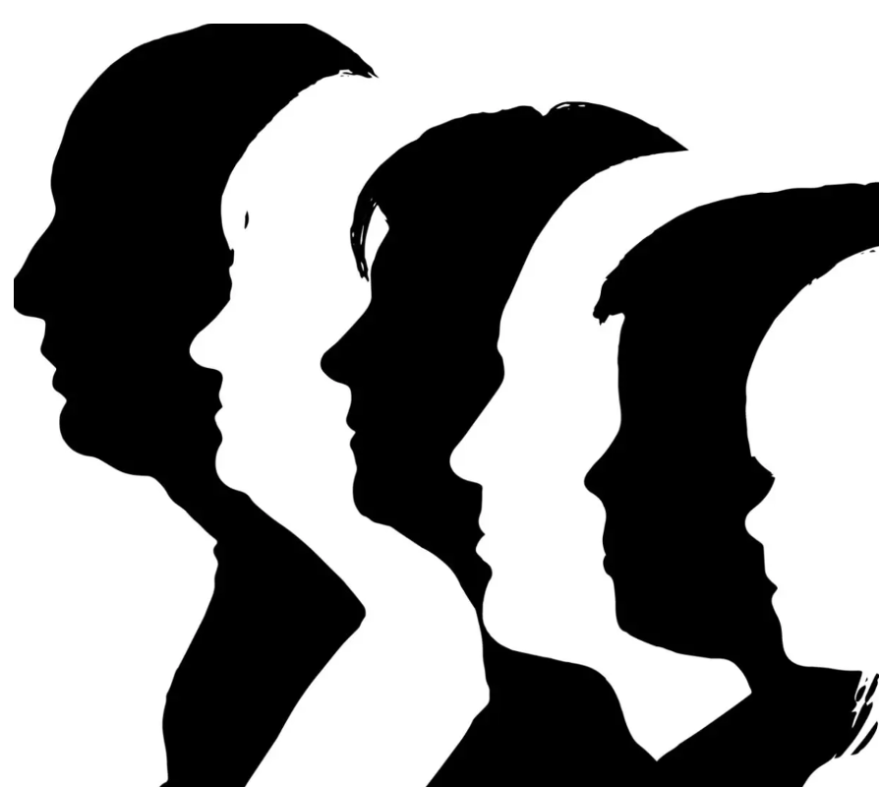
What Does Inclusion Mean for FJMC International?
For a men’s organization like FJMC International—whose historical membership base is indeed mostly white, cisgender, Jewish men—the work of inclusion means being especially mindful of men (and families) who don’t fit that mold but still deserve to feel fully welcomed and supported.
In short, inclusion here isn’t just about “being nice”—it’s about making sure any man who walks into an FJMC space doesn’t feel like he’s an outsider. This requires intentional language, diverse representation in leadership, program topics that reflect varied experiences, and explicit signals of welcome (e.g., partnerships with Jews of Color Initiative, Keshet, or interfaith family groups).

Slide 3
Key groups to be sensitive and intentional about
1. Men of Color in the Jewish Community
Jewish men who are Black, Latino, Asian, or multiracial.
Converts to Judaism and their children.
Men in multicultural households where Jewish identity intersects with other racial/ethnic heritages.
2. GBTQ+ Jewish Men
Gay, bisexual, and queer men.
Transgender men and nonbinary individuals who want to engage in Jewish men’s spaces.
Men in same-sex partnerships raising Jewish families.

Slide 4
Key groups (cont’d)
3. Men in Interfaith / Multifaith Families
Jewish men married to non-Jews who are raising Jewish children.
Non-Jewish men raising Jewish children with Jewish partners.
Men navigating multiple faith or cultural traditions in the home.
4. Younger Generations
Men under 30 or 40 who often feel excluded from traditional synagogue-based men’s club structures.
Single men without families, who may feel overlooked compared to men with spouses and children.

Slide 5
Key groups (cont’d)
5. Men in Vulnerable Life Situations
Divorced, widowed, or single fathers.
Men struggling with mental health, unemployment, or financial hardship.
Men who feel alienated from Jewish communal life due to politics, theology, or personal experiences.
6. Jewish Men with Disabilities
Men with visible and invisible disabilities (physical, developmental, neurodivergent, or chronic illness).
Men who may feel excluded by physical accessibility barriers or by programming that assumes able-bodied participation.
Men who experience stigma or shame connected to their disability, making inclusion efforts and visible accessibility commitments vital.

Slide 6
Some suggested actions
Establish or work with an inclusion committee at your synagogue.
Seek rabbinic support – a public statement of support or sermon.
Place welcoming language on the synagogue’s website landing page.
Identify inclusionary practices to adopt.
Publicize inclusionary practices internally and in the community.
Engage others in dialogue about inclusion.
Support B’nai Mitzvahs and religious school engagement equally for children with and without disabilities/challenges.

Slide 7
Suggested programs
      Conduct HMV (Hearing Men’s Voices) sessions on inclusion.
      Create events to describe inclusion efforts.
      Invite clergy or speakers to describe why and how inclusionary practices should be enhanced.
      Encourage others to be welcoming to all they encounter and open to new relationships.
      Teach welcoming at gatherings of young and old alike.
      Create opportunities to create a dialogue with those in traditionally marginalized communities.

Slide 8
Keep In Mind
Our goal is to change the culture of our interactions to create an environment that makes all of us, no matter our unique identities and needs, feel welcomed and embraced in our community.
Questions
Comments
Commitments
Thank you

Slide 9
Bridging the Gap Between Us -- Inclusion
LET’S DO THIS: Making sure any man who walks into an FJMC space doesn’t feel like an outsider

